Slide 1

6. Statistics
The actual study of statistics involves Four steps :
1. Collection of data
2. Classification of data
3. Analysis of data
4. Interpretation of data
But GRE is concerned about the measures of central tendencies
There are three measures
1. Mean 2. Median 3. Mode

Slide 2


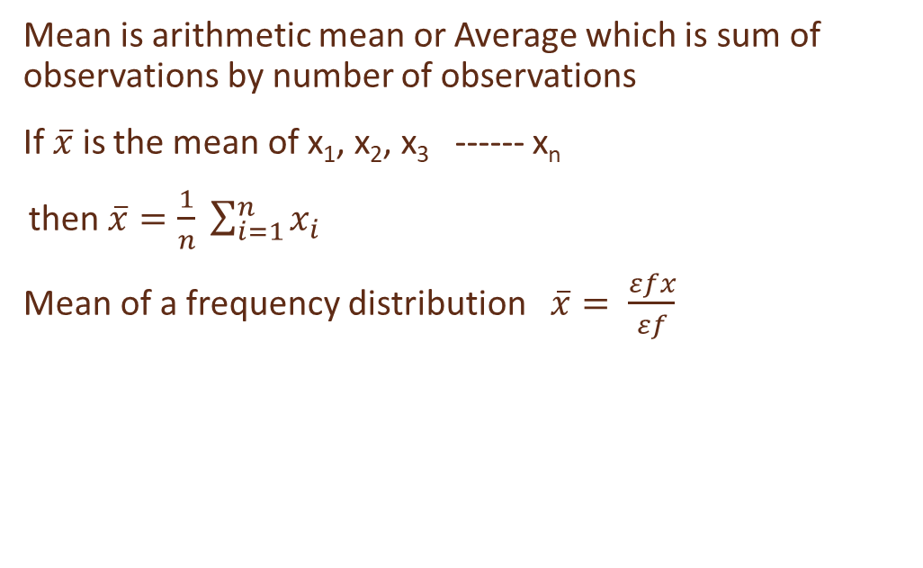
Mean
Mean is arithmetic mean or Average which is sum of observations by number of observations
If $\overline{x}$ is the mean of x₁, x₂, x₃ ------ x_{n}
then $\overline{x}=\frac{1}{n} \sum_{i=1}^{n}{x_{i}}$
Mean of a frequency distribution $\overline{x}= \frac{εfx}{εf}$

Slide 3

Mean
Find $\overline{x}$
x f
1 15
2 27
3 8
4 5
$\overline{x }=$113/55 = 2.05
:
x | f | fx
1 | 15 | 15
2 | 27 | 54
3 | 8 | 24
4 | 5 | 20
TOTAL | 55 | 113

Slide 4
EXERCISE
Find mean of:
c i | f
0-10 | 9
10-20 | 11
20-30 | 13
30-40 | 17
40-50 | 20

Slide 5
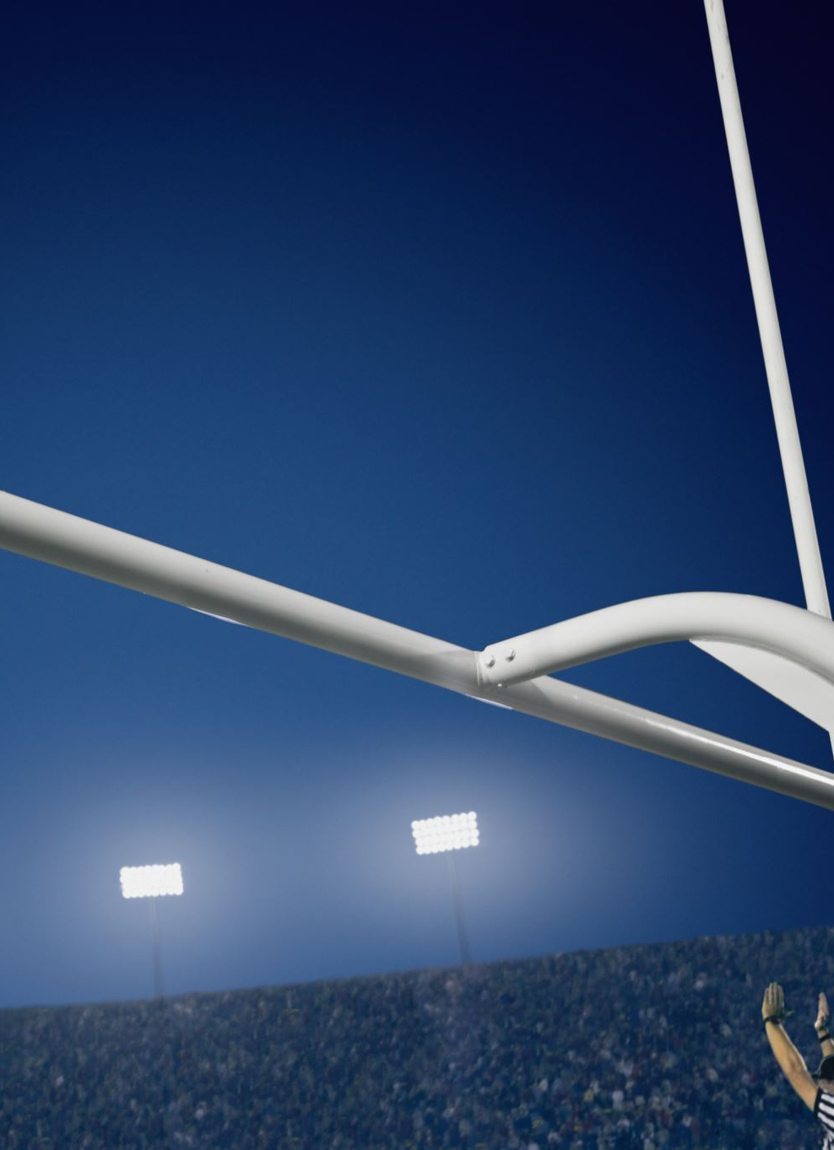
Mean
There were 5 members of a basketball team who had a mean points score of 12 points per game. One of the team members left, causing the average point score to reduce to 10 points per game. What was the mean score of the player that left?
Given five members Average score= 12
Therefore, the total score of these five players= 12 x 5=60 points.
When one of them left the average dropped to 10 points per game.
So the total score when that player left= 10 x 4=40
Now when we calculate the difference we get,
60-40= 20 points.
Therefore the score of the player who left was 20.

Slide 6

Mean
The mean length of 7 planks of wood is 1.35m. When an extra plank of wood is added, the mean length of a plank of wood increase to 1.4m. What is the length of the extra plank of wood that was added?
If the mean length of 7 planks of wood is 1.35m, then the total length of all these planks of wood combined can be calculated as 7×1.35m = 9.45m
When the extra plank of wood is added, the mean length of a plank of wood increases to 1.4m. This means there are now 8 planks of wood, with a combined length of: 8×1.40m =11.2m
The length of this extra plank of wood is therefore: 11.2m −9.45m = 1.75m
.Short cut : The length of the new plank = 1.40 + ( 7 x 0.05) = 1.40 + 0.35 = 1.75 m

Slide 7
Find Mean
Find the mean of first ten natural numbers.
The mean = 1 + 2 +3+4 +5 +6 +7+8+9+10 = 55/10 = 5.5
10
Find the mean of first 5 prime numbers.
The mean = 2+3+5+7+11 = 5.6
5

Slide 8

example
The mean of 8, 11, 6, 14, x and 13 is 12. Find the value of the observation x.
The mean of 6, 8, x + 2, 10, 2x - 1, and 2 is 9. Find the value of x and also the value of the observation in the data.

Slide 9
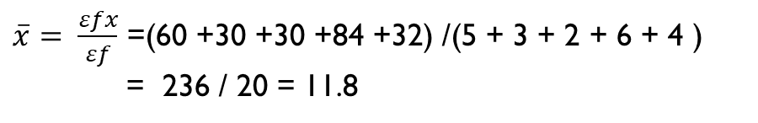
mean
Find the mean of the following distribution.
The age of 20 boys in a locality is given below.
Age in Years | 12 | 10 | 15 | 14 | 8
Number of Boys | 5 | 3 | 2 | 6 | 4
$\overline{x}= \frac{εfx}{εf}$ =(60 +30 +30 +84 +32) /(5 + 3 + 2 + 6 + 4 )
= 236 / 20 = 11.8

Slide 10
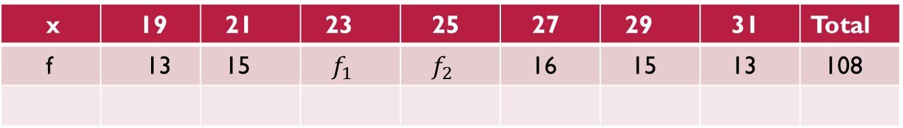
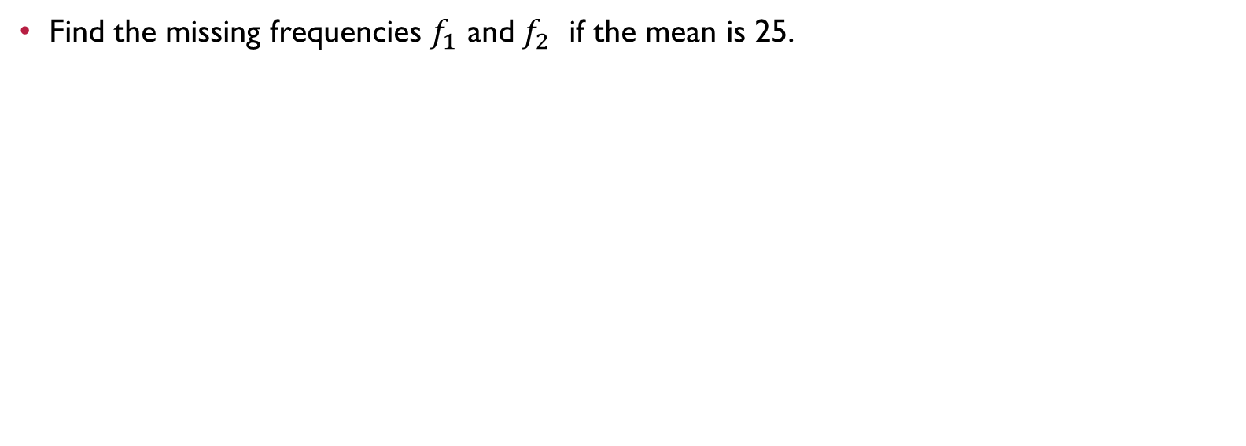
Mean
Find the missing frequencies $f_{1}$ and $f_{2}$ if the mean is 25.
x | 19 | 21 | 23 | 25 | 27 | 29 | 31 | Total
f | 13 | 15 | $f_{1}$ | $f_{2}$ | 16 | 15 | 13 | 108

Slide 11
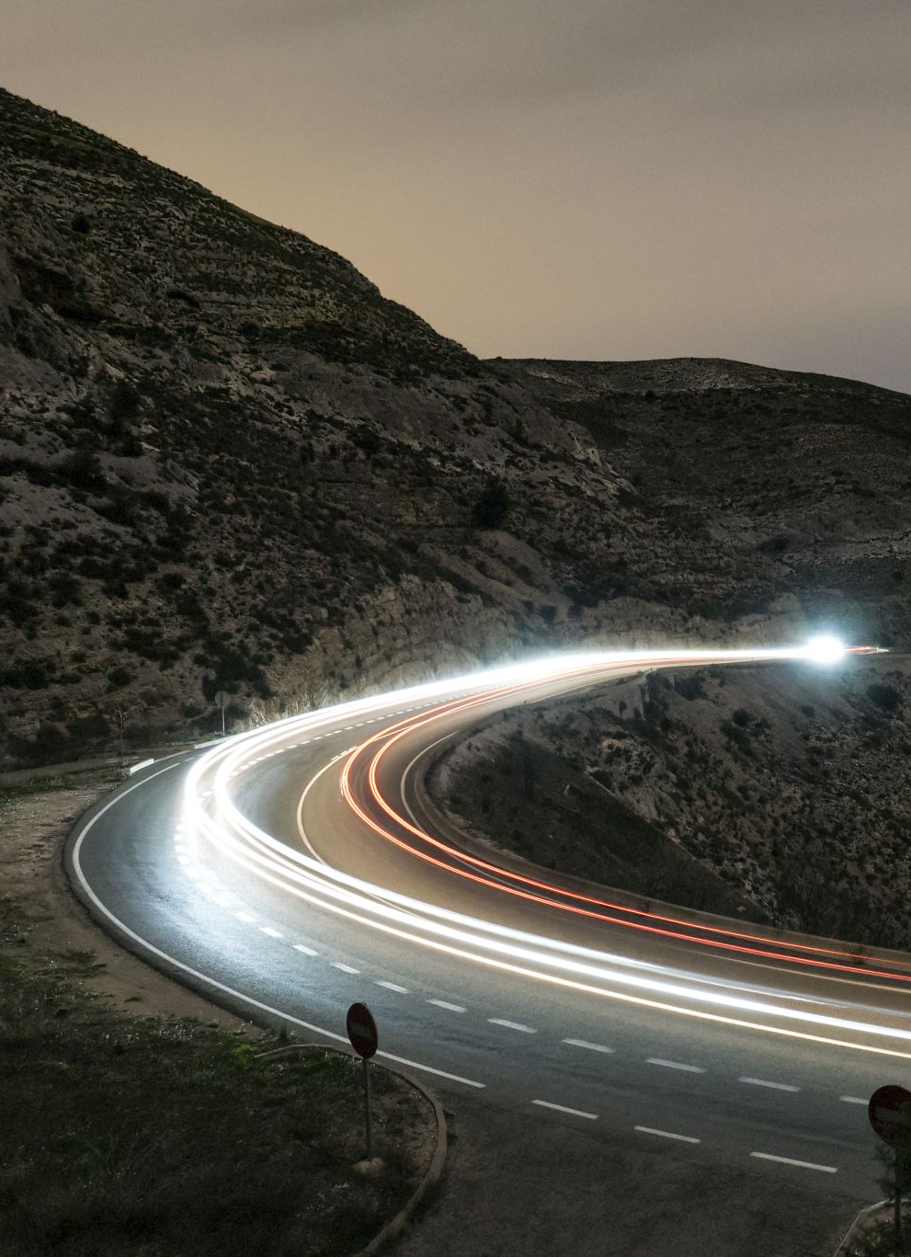
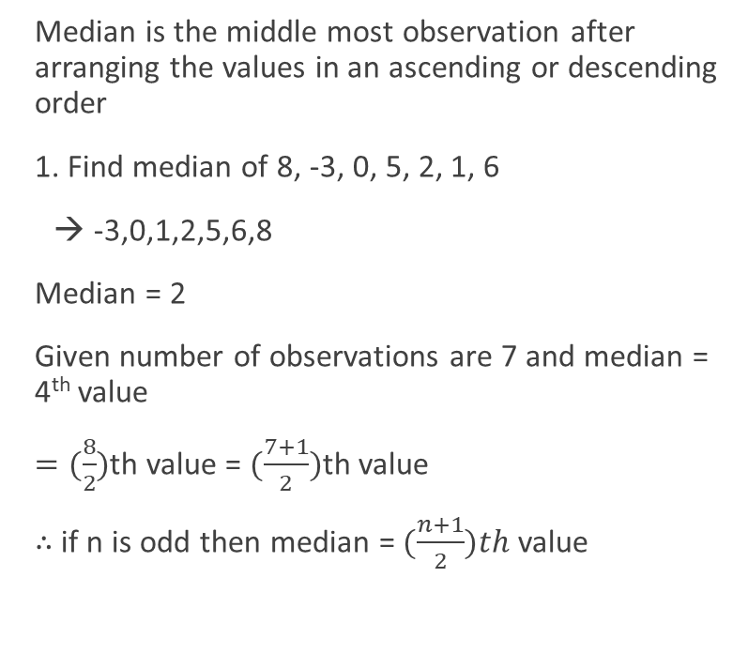
Median
Median is the middle most observation after arranging the values in an ascending or descending order
1. Find median of 8, -3, 0, 5, 2, 1, 6
→ -3,0,1,2,5,6,8
Median = 2
Given number of observations are 7 and median = 4th value
$=(\frac{8}{2})$th value = $(\frac{7+1}{2})$th value
∴ if n is odd then median = $(\frac{n+1}{2})th$ value

Slide 12
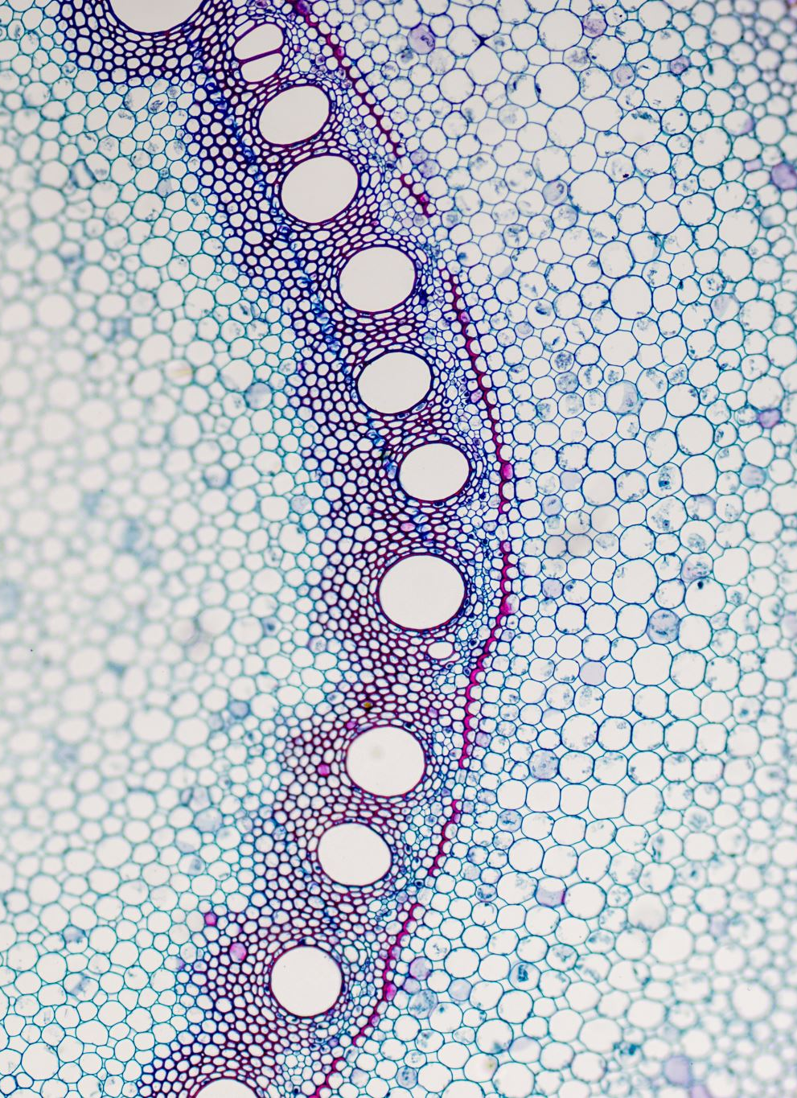
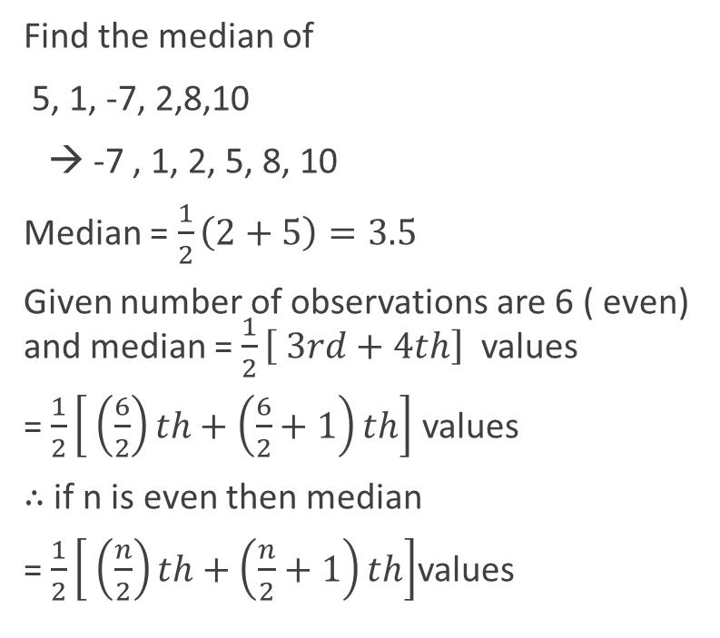
Median
Find the median of
5, 1, -7, 2,8,10
→ -7 , 1, 2, 5, 8, 10
Median = $\frac{1}{2}\left(2+5\right)=3.5$
Given number of observations are 6 ( even) and median = $\frac{1}{2}\left[ 3rd+4th\right]$ values
= $\frac{1}{2}\left[ \left(\frac{6}{2}\right)th+\left(\frac{6}{2}+1\right)th\right]$ values
∴ if n is even then median
= $\frac{1}{2}\left[ \left(\frac{n}{2}\right)th+\left(\frac{n}{2}+1\right)th\right]$values

Slide 13
Median
Find the median of the following data.
(a) 27, 39, 49, 20, 21, 28, 38
(b) 10, 19, 54, 80, 15, 16
(c) 47, 41, 52, 43, 56, 35, 49, 55, 42
(d) 12, 17, 3, 14, 5, 8, 7, 15

Slide 14

Median
The following observations are arranged in ascending order. The median of the data is 25 find the value of x.
17, x, 24, x + 7, 35, 36, 46

Slide 15

Example
9 people take a test. Their scores out of 100 are:
56,79,77,48,90,68,79,92,71
Work out the mean, median, and mode of their scores.

Slide 16

solution
56,79,77,48,90,68,79,92,71

Slide 17

Mode
Mode is the most often occurring observation
Mode of 1,3,2,3,4,3 is 3
If two observations occur the same number of times, then it is BI – MODAL
If each observation occurs the same number of times, then ‘there is NO MODE ‘

Slide 18

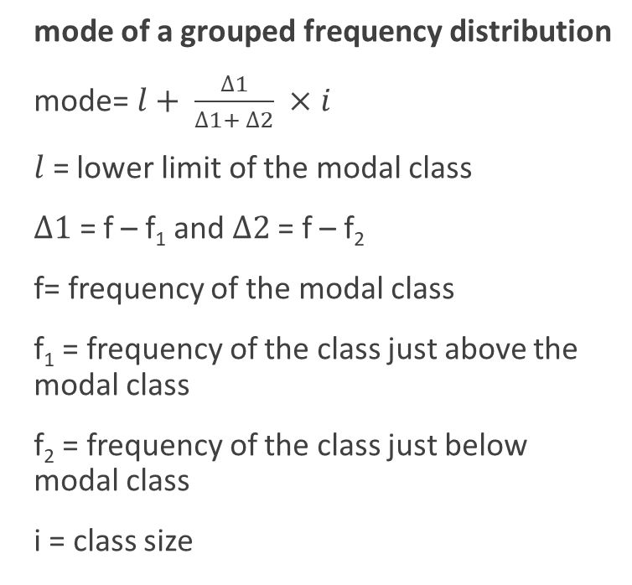
Mode
mode of a grouped frequency distribution
mode=$l+ \frac{∆1}{∆1+ ∆2} ×i$
$l$ = lower limit of the modal class
$∆1$ = f – f₁ and $∆2$ = f – f₂
f= frequency of the modal class
f₁ = frequency of the class just above the modal class
f₂ = frequency of the class just below modal class
i = class size

Slide 19
exercise
Find mode :
c i | f
0-10 | 2
10-20 | 4
20-30 | 5
30-40 | 6
40-50 | 3

Slide 20

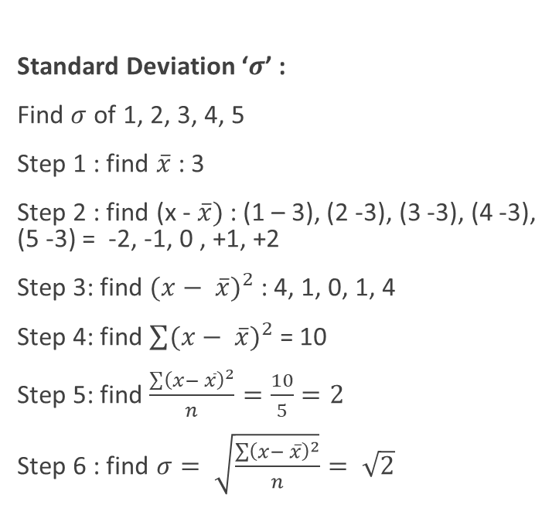
Standard Deviation
Standard Deviation ‘$σ$’ :
Find $σ$ of 1, 2, 3, 4, 5
Step 1 : find $\overline{x}$ : 3
Step 2 : find (x - $\overline{x})$ : (1 – 3), (2 -3), (3 -3), (4 -3), (5 -3) = -2, -1, 0 , +1, +2
Step 3: find ${(x− \overline{x})}^{2}$ : 4, 1, 0, 1, 4
Step 4: find $\sum{{(x− \overline{x})}^{2}}$ = 10
Step 5: find $\frac{\sum{{\left(x− \overline{x}\right)}^{2}}}{n}=\frac{10}{5}=2$
Step 6 : find $σ= \sqrt{\frac{\sum{{\left(x− \overline{x}\right)}^{2}}}{n}}= \sqrt{2}$

Slide 21
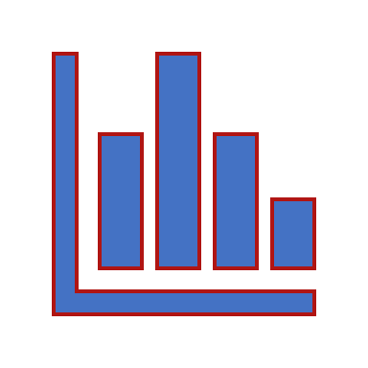
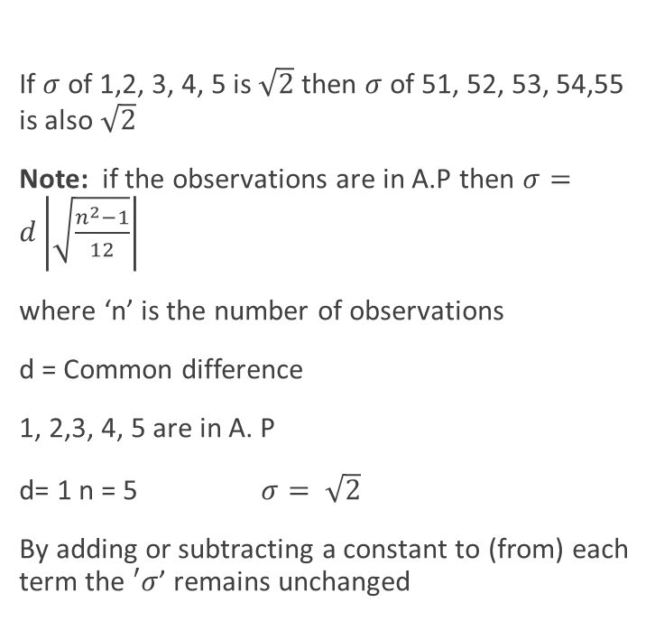
Standard Deviation
If $σ$ of 1,2, 3, 4, 5 is $\sqrt{2}$ then $σ$ of 51, 52, 53, 54,55 is also $\sqrt{2}$
Note: if the observations are in A.P then $σ=d\left|\sqrt{\frac{n^{2}−1}{12}}\right|$
where ‘n’ is the number of observations
d = Common difference
1, 2,3, 4, 5 are in A. P
d= 1 n = 5 $σ= \sqrt{2}$
By adding or subtracting a constant to (from) each term the $′σ$’ remains unchanged

Slide 22

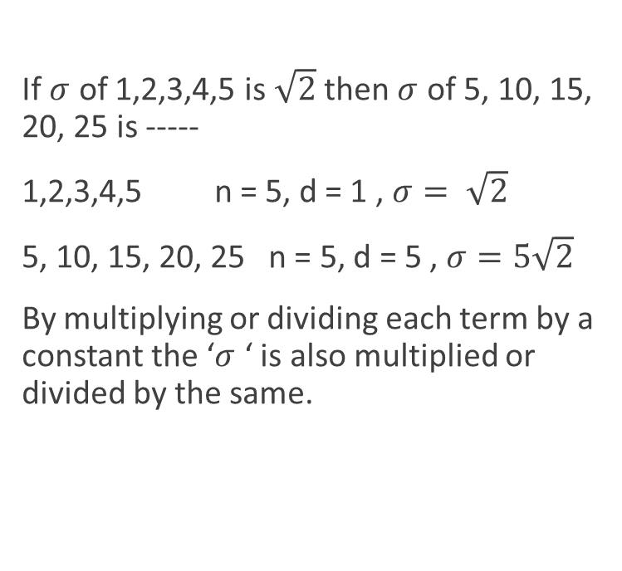
Standard Deviation
If $σ$ of 1,2,3,4,5 is $\sqrt{2}$ then $σ$ of 5, 10, 15, 20, 25 is -----
1,2,3,4,5 n = 5, d = 1 , $σ= \sqrt{2}$
5, 10, 15, 20, 25 n = 5, d = 5 , $σ=5\sqrt{2}$
By multiplying or dividing each term by a constant the ‘$σ$ ‘ is also multiplied or divided by the same.

Slide 23
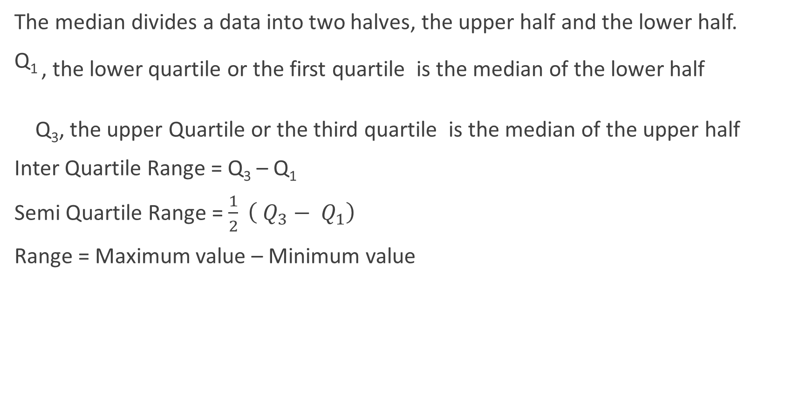
Quartiles
The median divides a data into two halves, the upper half and the lower half.
Q1 , the lower quartile or the first quartile is the median of the lower half
Q₃, the upper Quartile or the third quartile is the median of the upper half
Inter Quartile Range = Q₃ – Q₁
Semi Quartile Range = $\frac{1}{2} \left( Q_{3}− Q_{1}\right)$
Range = Maximum value – Minimum value

Slide 24
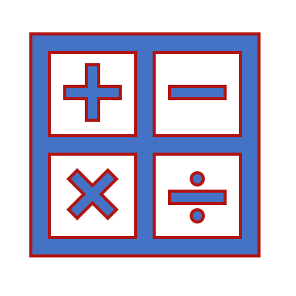
exercise
Find mean, Median, Mode Q₁, Q₃ Inter Quartile Range and Range of
15,16, 17, 18, 15, 15, 19, 12, 13, 20

Slide 25
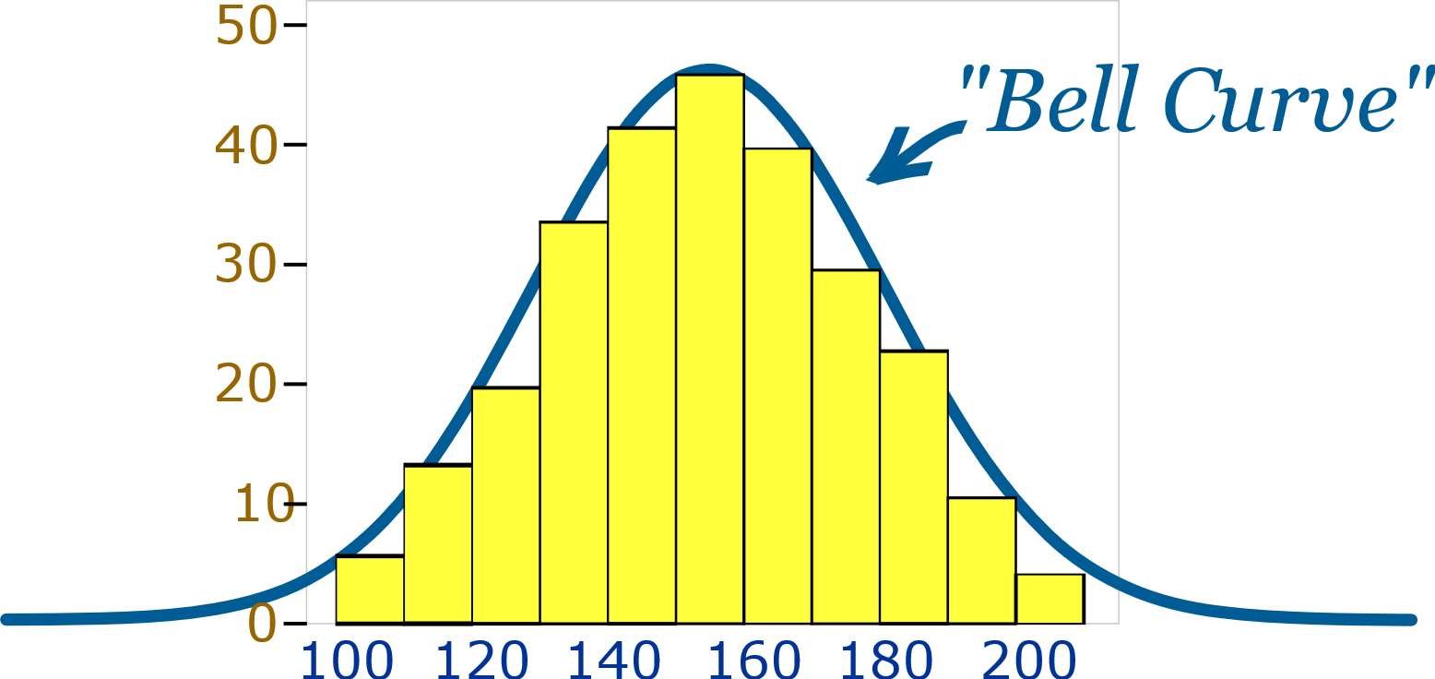
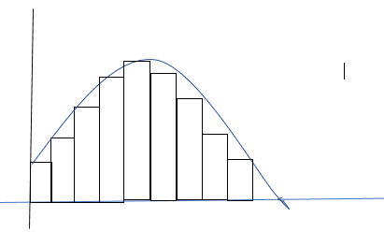
Normal Distribution Bell Curve
If we connect the vertices of these bar chart which is evenly distributed, we get a curve called a Bell curve.

Slide 26
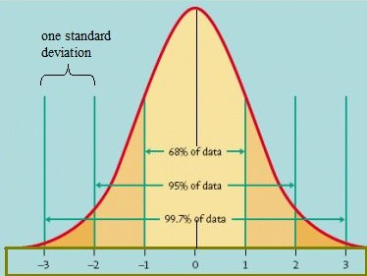
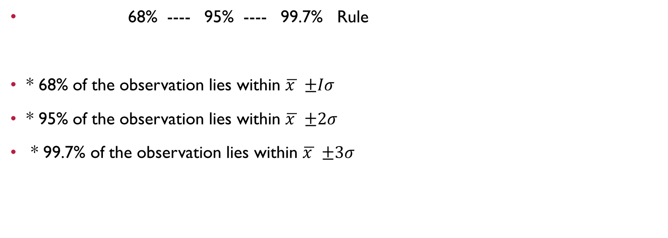
Normal distribution
68% ---- 95% ---- 99.7% Rule
* 68% of the observation lies within $\overline{x }$ $±Iσ$
* 95% of the observation lies within $\overline{x }$ $±2σ$
* 99.7% of the observation lies within $\overline{x }$ $±3σ$

Slide 27
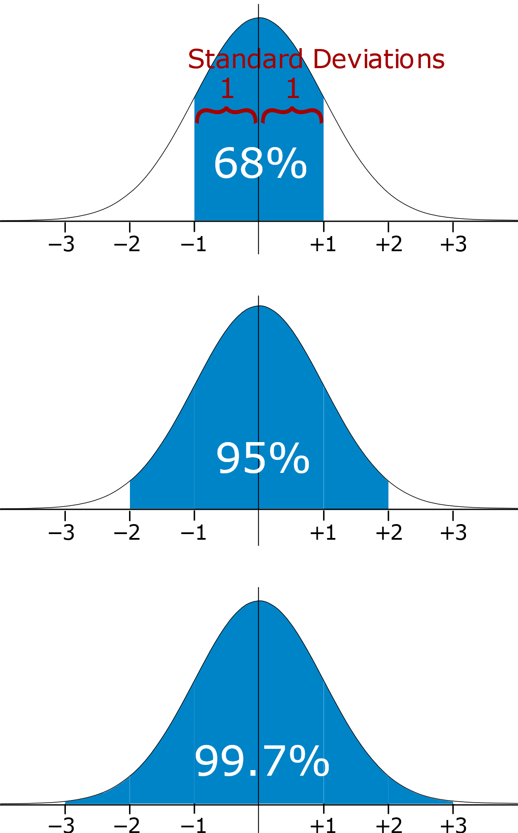
Normal distribution

Slide 28

Normal distribution
The normal curve is a graphical model of a normal distribution. The graph won’t be shown on the GRE, but visualizing it lets you quickly calculate the percent of data above or below a given value using the standard deviation.
The area under a normal curve is 100%.
50% of the values are above the mean and 50% are below.
About 68% of the values are within 1 standard deviation of the mean.
About 95% of the values are within 2 standard deviations of the mean.
About 99.7% of the values are within 3 standard deviations of the mean.

Slide 29
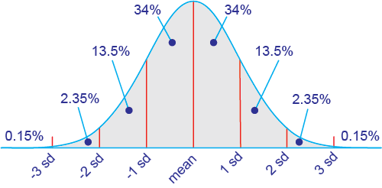
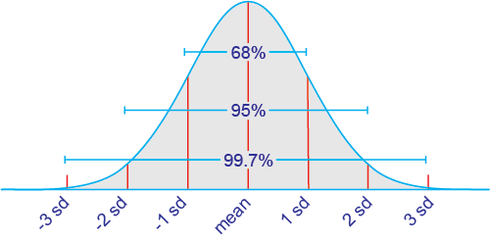
example

Slide 30
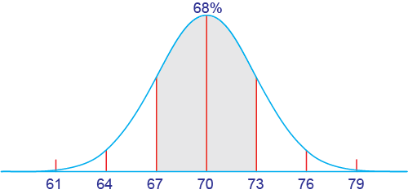
Example
The average men’s height in the US is 70 inches ± 3 inches.
(a) What percent of men are between 67 and 73 inches tall? (b) What percent of men are between 64 and 70 inches tall? (c) What percent of men are taller than 79 inches?
The symbol ±, “plus or minus,” is sometimes used to give the value of 1 standard deviation, so in this case the standard deviation of heights is 3 inches.
a) Compare 67 and 73 to the mean, 70. Both are 1 standard deviation from the mean. About 68% of the area is within 1 standard deviation of the mean, so 68% of men are between 67 and 73 inches tall.

Slide 31
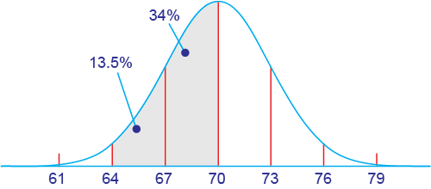
solution
b) Compare 64 and 70 to the mean, 70. 64 is 2 standard deviations below the mean, and 70 is the mean. The area between 2 standard deviations and the mean is about (34 + 13.5)% = 47.5%, so about 48% of men are between 64 and 70 inches tall.

Slide 32
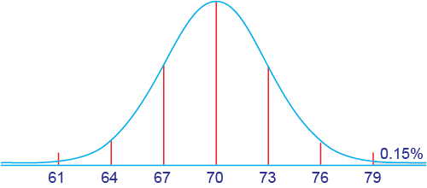
solution
(c) Compare 79 to the mean, 70. It is 3 standard deviations from the mean. The area above 3 standard deviations is about 0.15%. About 15 out of 10,000 men are taller than 79 inches (6 foot 7 inches).

Slide 33

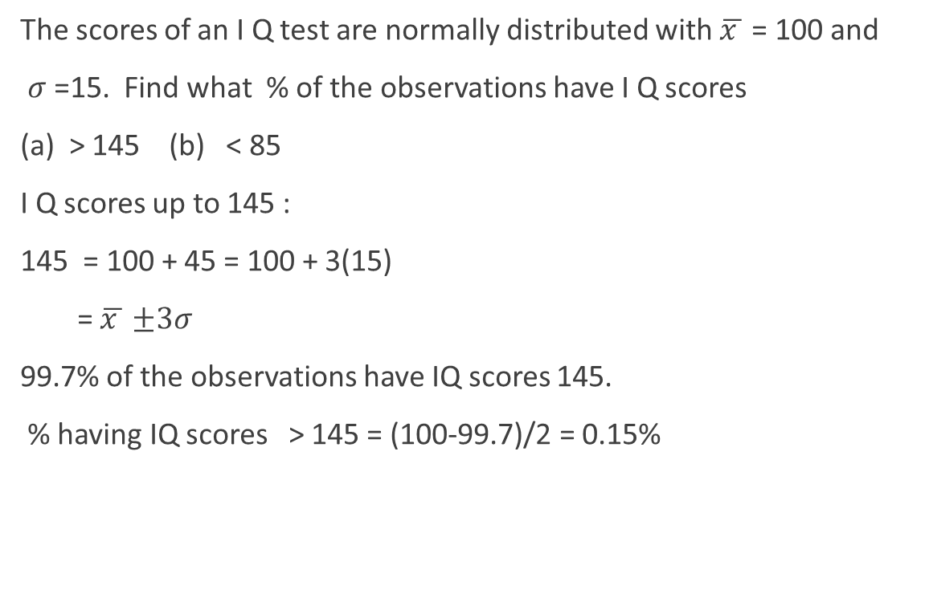
exercise
The scores of an I Q test are normally distributed with $\overline{x }$ = 100 and
$σ$ =15. Find what % of the observations have I Q scores
(a) > 145 (b) < 85
I Q scores up to 145 :
145 = 100 + 45 = 100 + 3(15)
= $\overline{x }$ $±3σ$
99.7% of the observations have IQ scores 145.
% having IQ scores > 145 = (100-99.7)/2 = 0.15%

Slide 34
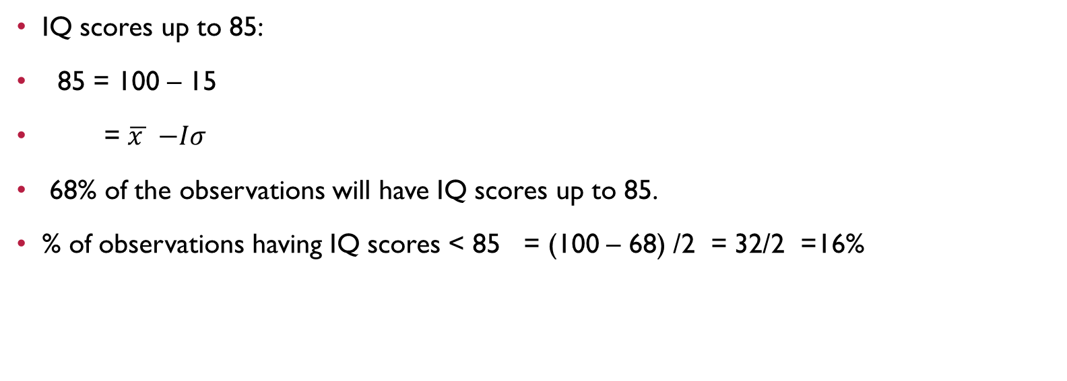
example
IQ scores up to 85:
85 = 100 – 15
= $\overline{x }$ $−Iσ$
68% of the observations will have IQ scores up to 85.
% of observations having IQ scores < 85 = (100 – 68) /2 = 32/2 =16%

Slide 35
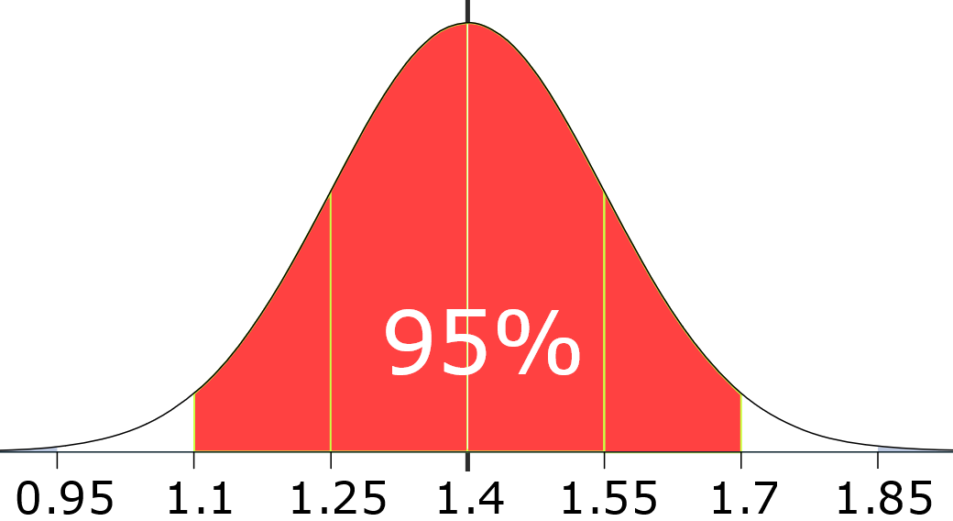
Example: 95% of students at school are between 1.1m and 1.7m tall. Assuming this data is normally distributed can you calculate the mean and standard deviation?
The mean is halfway between 1.1m and 1.7m:
Mean = (1.1m + 1.7m) / 2 = 1.4m
95% is 2 standard deviations either side of the mean (a total of 4 standard deviations) so:
1 standard deviation | = (1.7m-1.1m) / 4
 | = 0.6m / 4
 | = 0.15m

